Slide 1
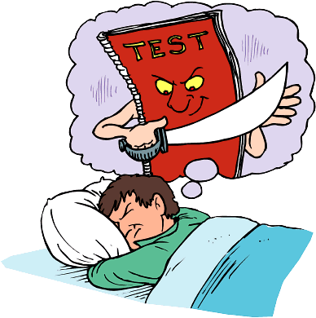
Study Skills
The Basics L.C
Jesus and Mary College
Notes:
All blue underlined text is a hyperlink to something or other

Slide 2
How Much time do I Have?
http://days.to/1-june
How many hours a night am I willing to STUDY?
Multiply it out….

Slide 3


Slide 4
How should I organise this time?
Mon | Tue | Wed | Thur | Fri | Sat | Sun

Slide 5
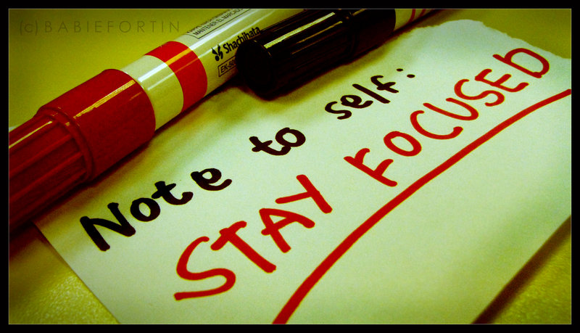
Read with a question in mind.

Slide 6
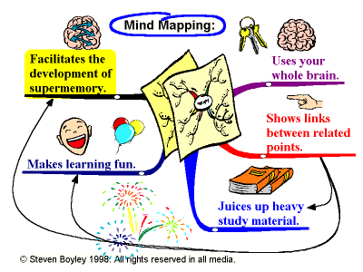

Slide 7
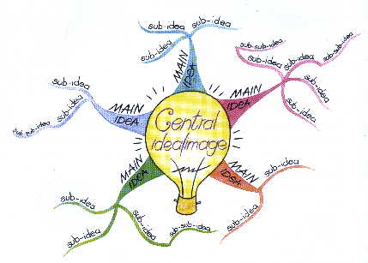

Slide 8
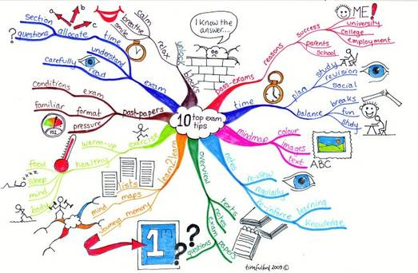

Slide 9
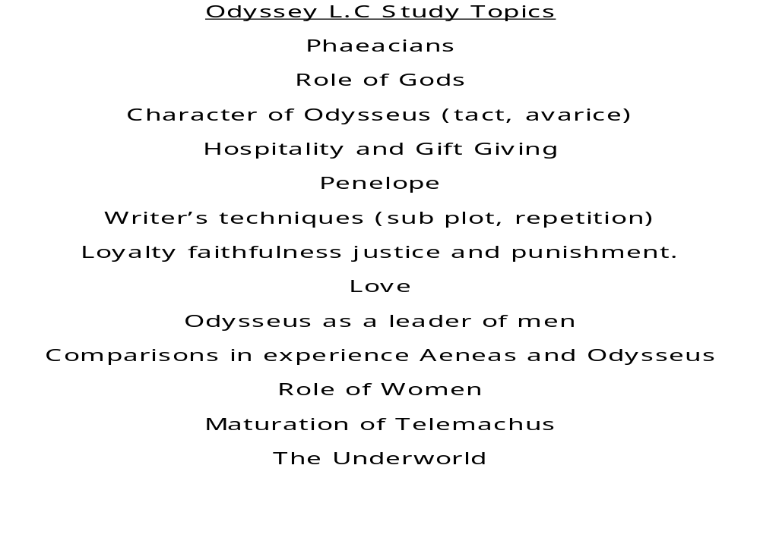
Classics LC

Slide 10
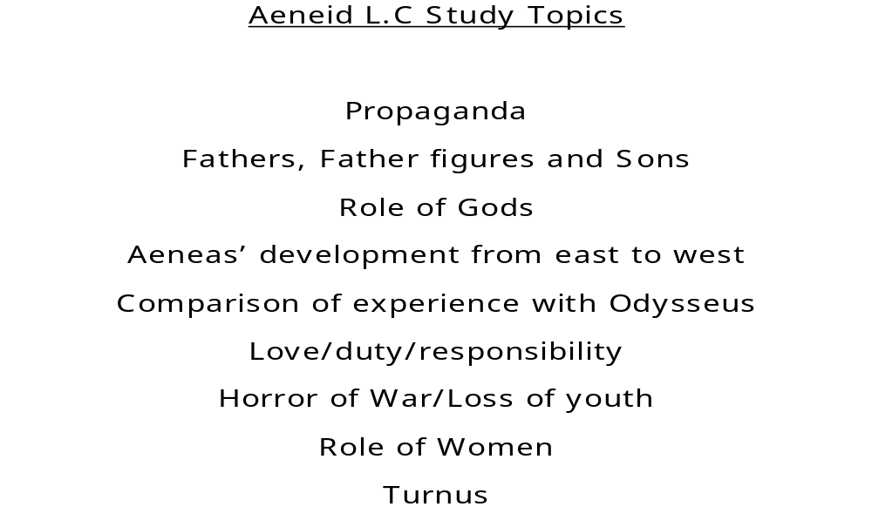
Classics LC 2

Slide 11


Slide 12
Helpful website
http://www.helpmestudynow.com/
Study Buddy

