Slide 1

STUDY GOALS MUST BE SMART
SPECIFIC: “I will have studied the whole chapter on rivers in Geog by Sunday”.
MEASURABLE: “I will measure my progress by ticking off the stages of the river on my revision checklist as I learn them”.
ACTION-RELATED: “I will break down my goal into specific tasks and concentrate on young stage tonight and maybe the mature stage tomorrow night”.
REALISTIC: I’m not going to go onto mountains aswell this week as that would be an overdose of geog!”
TIME: “I’m going to give myself the whole week to learn rivers as its a long chapter.”

Slide 2
SET YOUR WEEKS STUDY GOALS TONIGHT
MAKE SURE AND CHECK THEM NEXT SUNDAY TO SEE IF YOU’VE ACHIEVED THEM.
ACHIEVING YOUR GOALS WILL MAKE YOU FEEL GOOD AB0UT YOURSELF AND WILL MOTIVATE YOU TO SET NEXT WEEKS GOALS.
MAKE SURE AND SET PERSONAL GOALS ASWELL, SUCCESS IS NOT ALL ABOUT THE BOOKS!!!!!!!!!!!!MAYBE TRY AND GET FIT OR TRY TO ASK MORE QUESTIONS IN CLASS.

Slide 3
Tips for the revision period:
Leave plenty of time to revise so that you don't get into a situation of having to do last minute cramming. This approach will help to boost your confidence and reduce any pre-exam stress as you know you have prepared well.
Develop a timetable so that you can track and monitor your progress. Make sure you allow time for fun and relaxation so that you avoid burning out.
As soon as you notice your mind is losing concentration, take a short break. You will then come back to your revision refreshed.
Experiment with several alternative revision techniques so that revision is more fun and your motivation to study is high.
Don't drink too much coffee, tea and fizzy drinks; the caffeine will 'hype' you and make your thinking less clear. Eat healthily and regularly; your brain will benefit from the nutrients.
Regular moderate exercise will boost your energy, clear your mind and reduce any feelings of stress.
Try out some yoga, tai chi or relaxation techniques. They will help to keep you feeling calm and balanced, improve your concentration levels and help you to sleep better.

Slide 4
During the exams.
The quickest and most effective way of eliminating feelings of stress and panic is to close your eyes and take several long, slow deep breaths. Breathing in this way calms your whole nervous system. Simultaneously you could give yourself some mental pep-talk by mentally repeating "I am calm and relaxed" or "I know I will do fine".
If your mind goes blank, don't panic! Panicking will just make it harder to recall information. Instead, focus on slow, deep breathing for about one minute. If you still can't remember the information then move on to another question and return to this question later.
After the exam don't spend endless time criticising yourself for where you think you went wrong. Often our own self assessment is far too harsh. Congratulate yourself for the things you did right, learn from the bits where you know you could have done better, and then move on.

Slide 5
Read the instructions before starting the exam.
Ask the teacher or exam supervisor if anything is unclear.
Read through all the questions before starting writing, and make sure you are clear how many questions you are required to answer.
If there is a choice, start by answering the question you feel you can answer best.
If you are stuck on a question, go on to the next. You can always come back to it later. If you are really stuck, try to have an intelligent guess anyway. – there are no marks going for an empty space.
Leave time to read through and check your answers before the exam finishes.
Plan how much time you’ll need for each question

Slide 6
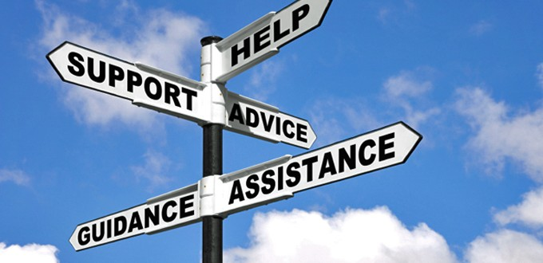
Most importantly, if you feel that your exam anxiety is building up to a point where sleep is difficult, your health is suffering or your relationships with your friends and family are starting to be affected you need to seek some help.

Slide 7
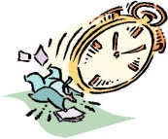

Establish a routine
DO set aside a particular time each day for study
and revision and stick to it.
DO see study as part of your daily routine this way it will be more acceptable to you and your study will be more productive.
DO have a definite time for starting study each evening and stick to it.
DO study at weekends. Try to get some work done before 7pm on Friday. Saturday mornings are often a good time as is Sunday when there are fewer distractions.
Set a timetable
DO have a timetable planning out what subjects you want to study over a period of time.
DO decide how long you will spend on
each subject and topic.
DON’T set an unrealistic timetable which will overwhelm you.

Slide 8
How to Revise…
 | MON | TUES | WEDS | THURS | FRI | SAT | SUN
Morning | SCHOOL | SCHOOL | SCHOOL | SCHOOL | SCHOOL | HIST - WW2 | FRENCH - writing
Afternoon | SCHOOL | SCHOOL | SCHOOL | SCHOOL | SCHOOL | RELAX | RECAP - WW2
Evening | MATHS - algebra | ENG – poems | BIOL - nerves | RECAP – algebra - poems | CHEM – salt | RECAP - nerves - salt | RELAX
Spend time making a thorough revision timetable and STICK TO IT

Slide 9
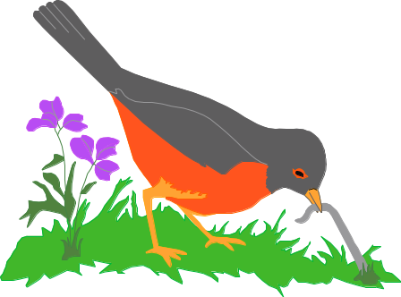
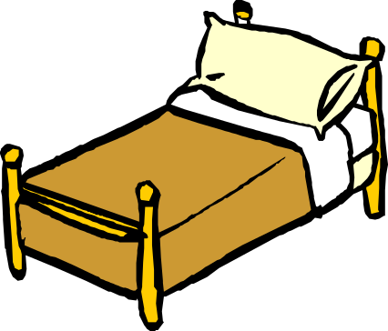
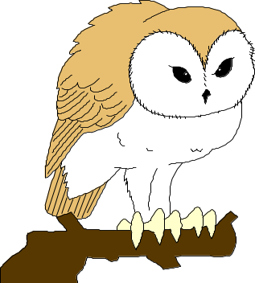
How to Revise…
What kind of person are you?
Some students are early birds.
They will definitely want to use the morning session
Late risers will avoid mornings like the plague! They will work well later in the day
Night owls will do their best revision in the evenings

