Slide 1
First Year
Introduction to Study & Examinations
In
Jesus & Mary College, Our Lady’s Grove

Slide 2
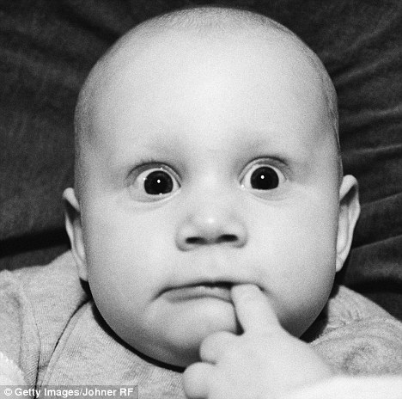
???Question time???
What are you worried about in relation to exams here in Jesus and Mary College?

Slide 3
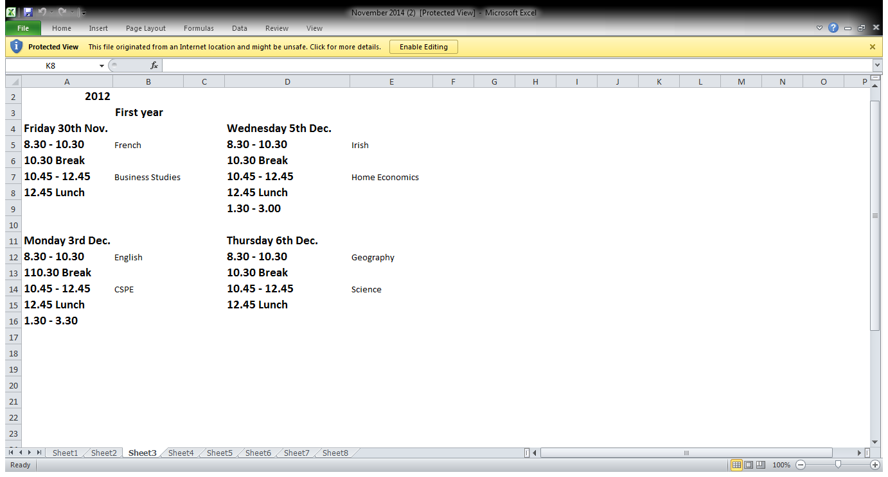
1. Exam Timetable

Slide 4

What to bring for exams

Slide 5
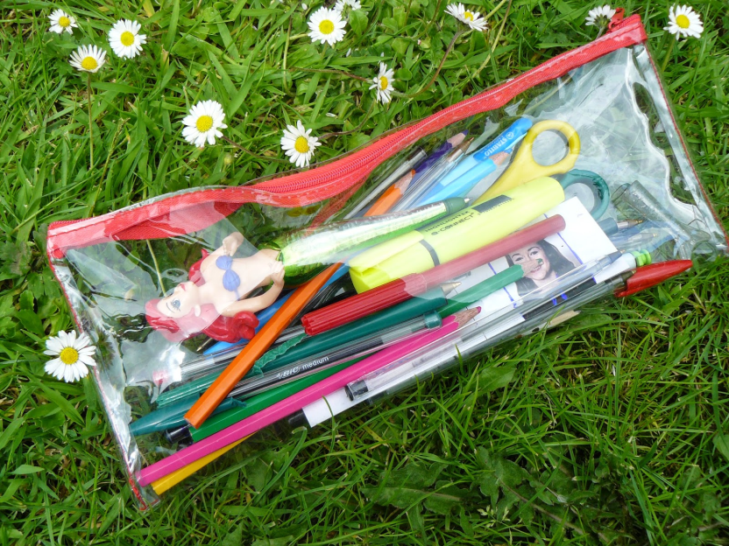
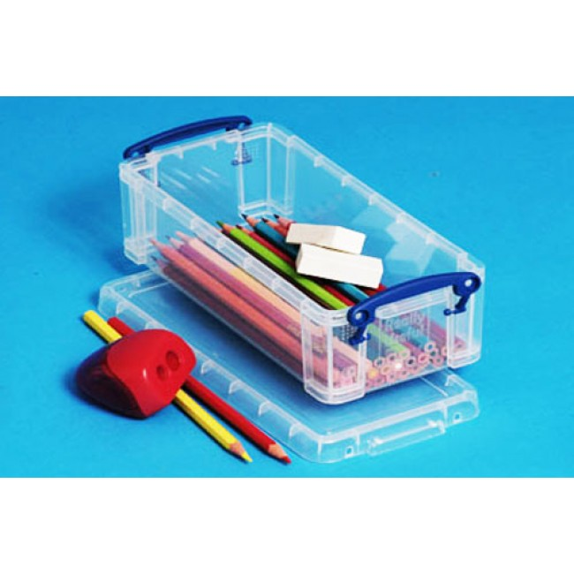
What to bring for Exams

Slide 6



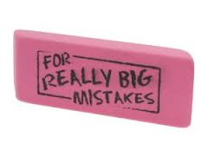
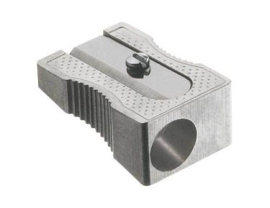
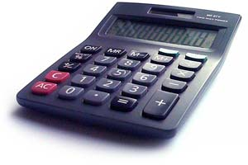
What to bring for exams
Spare Blue / Black pens
Red pens
Pencils
Colouring pencils
Eraser
Sharpener
Calculator

Slide 7
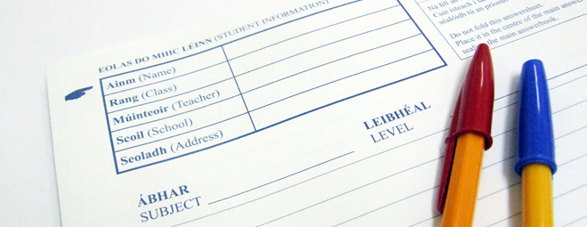
Paper is provided

Slide 8

Rules for Examinations
Students must be in full uniform!

Slide 9

Rules for Examinations
Students must remain in the examination centre for the duration of the exam

Slide 10

Rules for examinations
Students must be on time for all examinations

Slide 11

Rules for examinations
Students who are late for examinations will not be allowed extra time to complete their paper

Slide 12
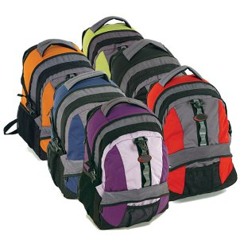
Rules for examinations
All bags, books, notes, pencil cases etc must be left at the top / bottom of the examination centre and should not be within reach of the students

Slide 13

Rules for examinations
A student must raise her hand if she wishes to attract the attention of the supervising teacher

Slide 14
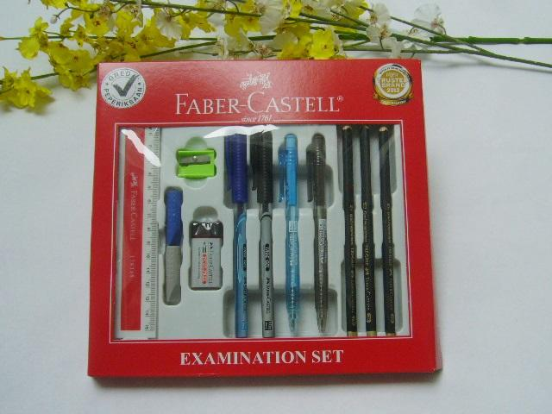
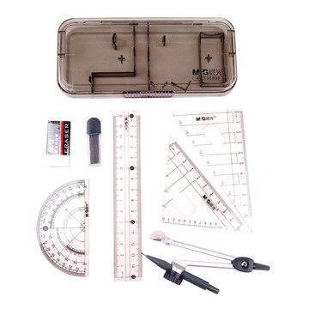
Rules for examinations
A student must bring their own equipment – no borrowing allowed

Slide 15

Rules for examinations
Students must sign a record sheet when handing up their papers.

Slide 16

Rules for examinations
No eating or drinking is permitted during examinations

Slide 17

Rules for examinations
Students must use the bathroom before the examination as they will not be permitted to leave the examination centre during examinations except in exceptional circumstances

Slide 18
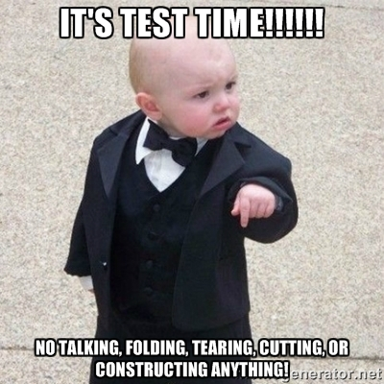
Rules for Examinations
Communication or attempted communication is forbidden for the duration of the examination and papers may be cancelled if such an attempt is made

Slide 19

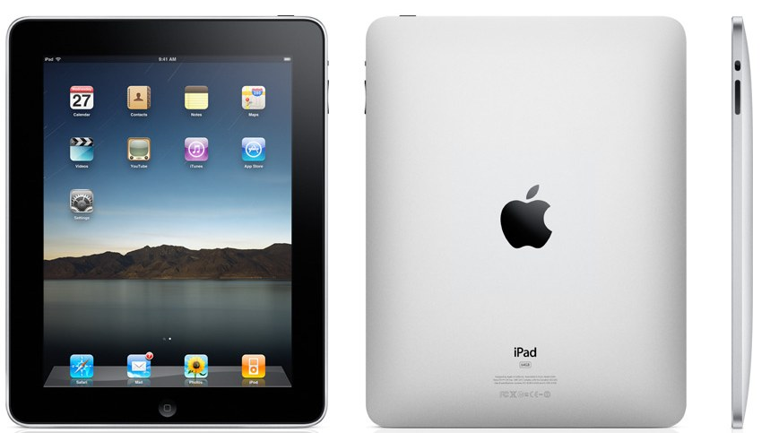
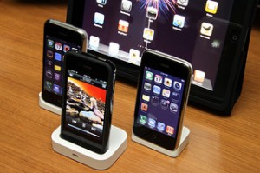
Rules for examinations
Possession of, or use of, prohibited electronic devices in the examination hall will result in the confiscation of the device and the cancellation of the exam paper

Slide 20

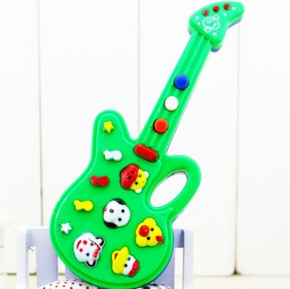
Rules for examinations
If a student misses an Oral or Practical examination she will not be allowed retake it and will lose the marks allocated for this section

Slide 21

Also…
A charge of €15 will be incurred if a phone is confiscated during an exam!

